Slide 1



Psychometric Assessments for Job Applications
© Laura Hooke, Loughborough University of London. Reviewer: Dr Kinga Zaczek, Royal Holloway, University of London
All mccp resources are released under a creative commons licence, www.mathcentre.ac.uk
www.sigma-network.ac.uk Psychometric Assessments for Job Applications
Notes:
This presentation is an introduction to the different methods that some employers in the UK use to assess applicants for jobs.

Slide 2
Recruitment process
When applying for jobs you may come across some if not all of the following stages in the recruitment process:
Completion of an online application form
Submission of a CV and cover letter
Tests (assessing skills appropriate for the job)*
Interview (face to face, video or telephone)
Assessment Centre (online/virtual or actual)
* Tests can occur at any stage of the recruitment process
Notes:
The process of applying for a job varies between employers. For some, submission of a CV and cover letter may be followed by an interview and hopefully, the offer of a job. For other, often larger organisations, there may be several stages to the process. At each stage, applicants may be rejected.
The stage at which the majority of applicants fail is often at the beginning with the submission of a CV or online application form. Common reasons for not passing the initial application stage include:
Not meeting the eligibility criteria e.g. Minimum qualifications requirement
Making errors e.g. Spelling and grammar mistakes
Tests are not used by all employers but are quite commonly used by larger organisations. They can be used at any stage of the recruitment process but are often the next stage after initial application. Tests are taken online so, to avoid fraud many employers will re-test at a later stage e.g. at assessment centre.

Slide 3
Current innovations in recruitment
Some of the large organisations in the UK that recruit students and graduates to internships, placements or graduate schemes are using new methods of assessment during selection e.g.
Online games & videos mirroring typical work scenarios & requiring decisions
Video interviews recorded online by the applicants & reviewed by the recruiter
Notes:
Some of the larger organisations in the UK are introducing new ways to assess applicants online including games and videos e.g. Barclays. Some incorporate elements of tests e.g. Situations that require decisions and interpretation of data. Look at the graduate recruitment pages of the Barclays website.

Slide 4
Common assessment tools
Ability or Aptitude Test
Including numerical reasoning, verbal reasoning, non-verbal reasoning
Personality Questionnaire
Less commonly used in recruitment
Situational Judgement Test (SJT)
Usually designed specifically for the needs of the job
Notes:
There are many different types of ability tests designed to assess different skills. Some are skills required in many jobs e.g. numerical and verbal reasoning. Others are specific to particular types of jobs e.g. in technology.

Slide 5

Companies that produce tests
Employers often buy tests produced by external organisations. Some of these organisations are:
Notes:
Many organisations buy tests from specialist companies. These are some of the well known companies that produce tests, but there are others. Most test producers include example questions or practice tests on their websites. A list of them appears later in this presentation.

Slide 6
Ability Tests
Measure a specific ability or abilities required for a job
Often bought from specialist companies
Examples:
numerical reasoning
verbal reasoning
non-verbal reasoning (diagrammatical, inductive, logical)
critical thinking
Notes:
Ability tests are sometimes also called ‘aptitude’ tests. They are designed to assess an applicant’s level of ability in a specific skill.

Slide 7
Examples of Ability Tests
Numerical Reasoning
  Tests are usually online and have a time limit.
  Some tests do not have a time limit for the test as a whole, but each question is timed, e.g. https://www.trytalentq.com/
  Maths skills tested may include calculation of percentages, fractions and ratios
  Questions often require interpretation of data in tables or graphs

Slide 8
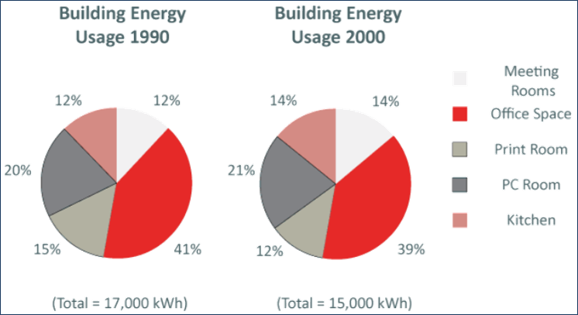
Between 1990 and 2000, what was the decrease in energy use for the PC Room, Meeting Rooms and Office Space combined?
a) 1,310 kWh b) 1,400 kWh c) 1,450 kWh d) Cannot say
Source: www.assessmentday.co.uk
Notes:
This is an example of a question from a numerical reasoning test, taken from one of the free practice tests on the Assessment Day website.

Slide 9
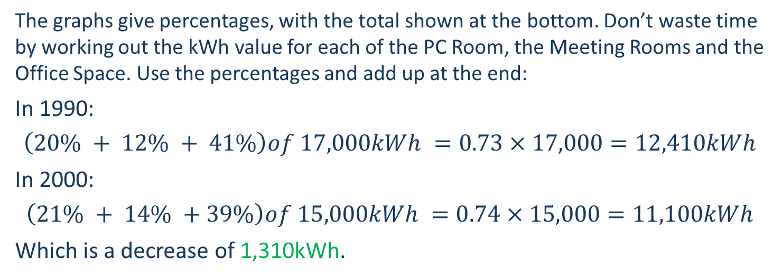
Between 1990 and 2000, what was the decrease in energy use for the PC Room, Meeting Rooms and Office Space combined? - ANSWER
The graphs give percentages, with the total shown at the bottom. Don’t waste time by working out the kWh value for each of the PC Room, the Meeting Rooms and the Office Space. Use the percentages and add up at the end:
In 1990:
$$\left(20\% + 12\% + 41\%\right)of 17,000kWh =0.73×17,000=12,410kWh$$
In 2000:
$$\left(21\% + 14\% +39\%\right)of 15,000kWh =0.74×15,000=11,100kWh$$
Which is a decrease of 1,310kWh.
Source: www.assessmentday.co.uk

Slide 10
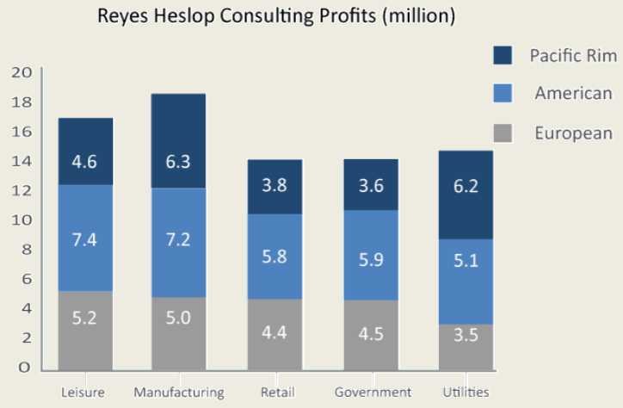
Which sector represents approximately 19% of the profits from the five sectors shown?
a) Leisure b) Manufacturing c) Retail d) Government e) Utilities
Source: www.assessmentday.co.uk
Notes:
This is an example of a question from a numerical reasoning test, taken from one of the free practice tests on the Assessment Day website.

Slide 11
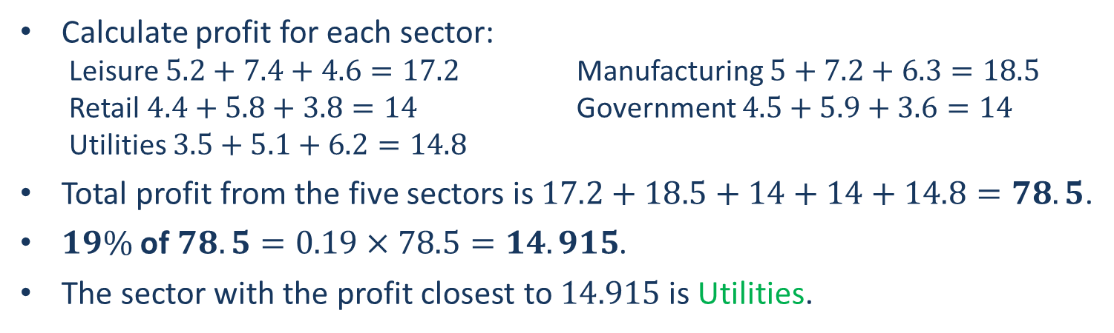
Which sector represents approximately 19% of the profits from the five sectors shown? - ANSWER
Calculate profit for each sector:
  Leisure $5.2+7.4+4.6=17.2$ Manufacturing $5+7.2+6.3=18.5$
  Retail $4.4+5.8+3.8=14$ Government $4.5+5.9+3.6=14$
  Utilities $3.5+5.1+6.2=14.8$
Total profit from the five sectors is $17.2+18.5+14+14+14.8=78.5$.
$19\%$ of $78.5=0.19×78.5=14.915$.
The sector with the profit closest to $14.915$ is Utilities.
Source: www.assessmentday.co.uk

Slide 12
Examples of Ability Tests
Verbal Reasoning
  Written passage followed by a question with possible True, False or Cannot Say responses
  Measure your powers of comprehension, reasoning, and logic

Slide 13
Read the text below and say whether the statement ‘An adults’ style can sometimes be similar to that of a child’s.’ is True, False, or you Cannot Say?
If society seems obsessed with youth, it is at least partly because companies are. Like it or not, the young increasingly pick the styles and brands that trickle up to the rest of the population. Nike, Abercrombie & Fitch and Timberland first found success with the young, and when that clientele tired of them the companies felt the loss deeply. Now that adults are no longer necessarily expected to act and look grown-up, parents and children can be found listening to exactly the same music, playing the same computer games, watching the same TV programmes, and wearing the same brands of clothes and shoes.
a) True b) False c) Cannot say
Source: www.assessmentday.co.uk
Notes:
This is an example of a question from a verbal reasoning test, taken from one of the free practice tests on the Assessment Day website.

Slide 14
Read the text below and say whether the statement ‘An adults’ style can sometimes be similar to that of a child’s.’ is True, False, or you Cannot Say? - ANSWER
If society seems obsessed with youth, it is at least partly because companies are. Like it or not, the young increasingly pick the styles and brands that trickle up to the rest of the population. Nike, Abercrombie & Fitch and Timberland first found success with the young, and when that clientele tired of them the companies felt the loss deeply. Now that adults are no longer necessarily expected to act and look grown-up, parents and children can be found listening to exactly the same music, playing the same computer games, watching the same TV programmes, and wearing the same brands of clothes and shoes.
Answer:
True - The sentence that proves this is ‘parent and children can be found listening to exactly the same music, playing the same videogames… and wearing the same brands of clothes and shoes [as the young]’.
Source: www.assessmentday.co.uk

Slide 15
Read the text below and say whether the statement ‘Adults wear the same shoes as children because they want to look younger.’ is True, False, or you Cannot Say?
If society seems obsessed with youth, it is at least partly because companies are. Like it or not, the young increasingly pick the styles and brands that trickle up to the rest of the population. Nike, Abercrombie & Fitch and Timberland first found success with the young, and when that clientele tired of them the companies felt the loss deeply. Now that adults are no longer necessarily expected to act and look grown-up, parents and children can be found listening to exactly the same music, playing the same computer games, watching the same TV programmes, and wearing the same brands of clothes and shoes.
a) True b) False c) Cannot say
Source: www.assessmentday.co.uk
Notes:
This is an example of a question from a verbal reasoning test, taken from one of the free practice tests on the Assessment Day website.

Slide 16
Read the text below and say whether the statement ‘An adults’ style can sometimes be similar to that of a child’s.’ is True, False, or you Cannot Say? - ANSWER
If society seems obsessed with youth, it is at least partly because companies are. Like it or not, the young increasingly pick the styles and brands that trickle up to the rest of the population. Nike, Abercrombie & Fitch and Timberland first found success with the young, and when that clientele tired of them the companies felt the loss deeply. Now that adults are no longer necessarily expected to act and look grown-up, parents and children can be found listening to exactly the same music, playing the same computer games, watching the same TV programmes, and wearing the same brands of clothes and shoes.
Answer:
Cannot say – the passage does not say why adults and children sometimes end up with the same styles. The passage implies that by listening to the same music and wearing the same clothes as young people, adults are not considered grown-up. But the passage does not say why some adults adopt this style (e.g. it could be price, comfort, or any number of reasons other than wanting to look younger, but we are not told).
Source: www.assessmentday.co.uk

Slide 17
Read the text below and say whether the statement ‘The profits of Timberland are not affected by young customers.’ is True, False, or you Cannot Say?
If society seems obsessed with youth, it is at least partly because companies are. Like it or not, the young increasingly pick the styles and brands that trickle up to the rest of the population. Nike, Abercrombie & Fitch and Timberland first found success with the young, and when that clientele tired of them the companies felt the loss deeply. Now that adults are no longer necessarily expected to act and look grown-up, parents and children can be found listening to exactly the same music, playing the same computer games, watching the same TV programmes, and wearing the same brands of clothes and shoes.
a) True b) False c) Cannot say
Source: www.assessmentday.co.uk
Notes:
This is an example of a question from a verbal reasoning test, taken from one of the free practice tests on the Assessment Day website.

Slide 18
Read the text below and say whether the statement ‘The profits of Timberland are not affected by young customers.’ is True, False, or you Cannot Say? - ANSWER
If society seems obsessed with youth, it is at least partly because companies are. Like it or not, the young increasingly pick the styles and brands that trickle up to the rest of the population. Nike, Abercrombie & Fitch and Timberland first found success with the young, and when that clientele tired of them the companies felt the loss deeply. Now that adults are no longer necessarily expected to act and look grown-up, parents and children can be found listening to exactly the same music, playing the same computer games, watching the same TV programmes, and wearing the same brands of clothes and shoes.
Answer:
False - The passage says that when ‘when that clientele [the young] tired of them the companies felt the loss deeply’. Meaning that Timberland’s profits are in fact closely affected by the purchasing habits of the young.
Source: www.assessmentday.co.uk

Slide 19
Examples of Ability Tests
Non-Verbal Reasoning
  Are often used to assess ability to problem solve & to think analytically
  The task is often to identify a missing shape in the sequence or decide which configuration should come next
  Examples include: diagrammatic reasoning, logical reasoning, inductive reasoning

Slide 20
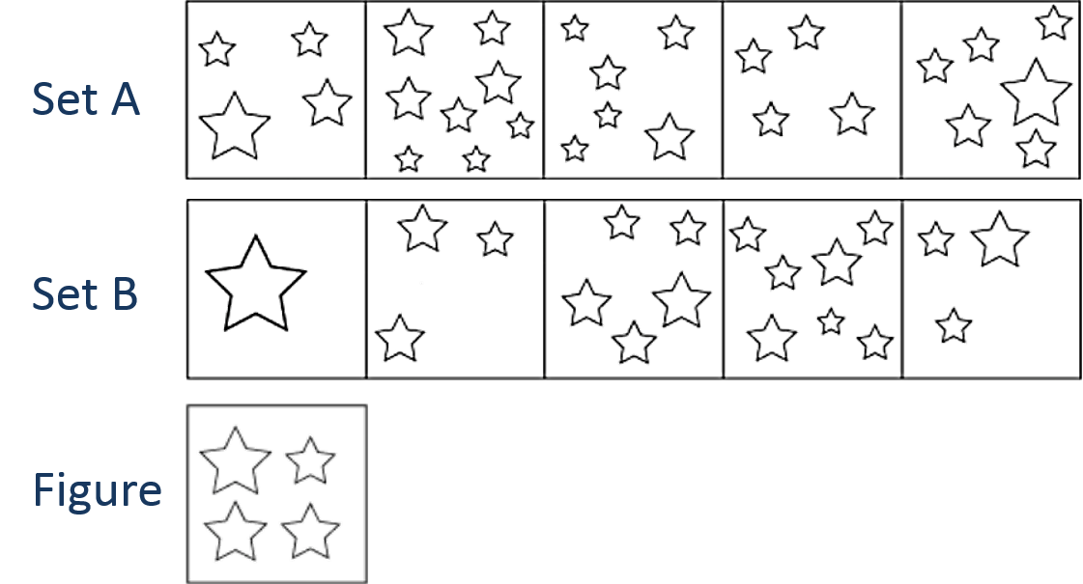
Which set does the Figure belong to?
Set A b) Set B c) Neither set A nor set B
Source: www.assessmentday.co.uk
Notes:
This is an example of a question from a diagrammatic reasoning test, taken from one of the free practice tests on the Assessment Day website.

Slide 21
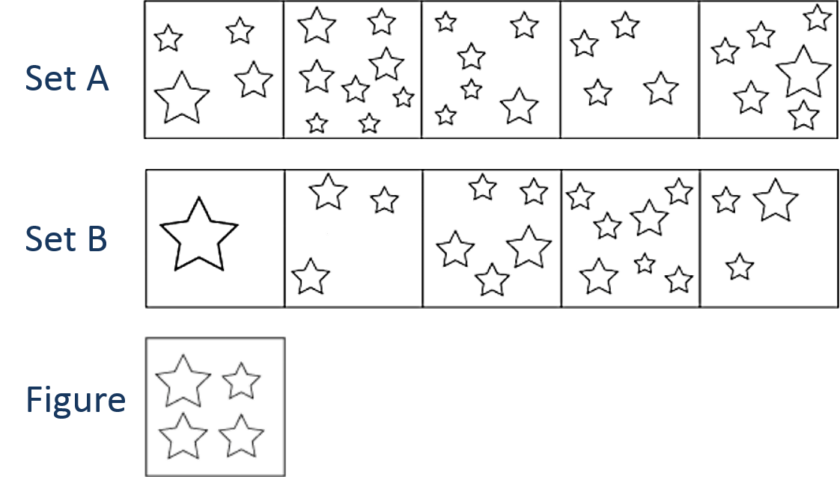
Which set does the Figure belong to? - ANSWER
Set A: Each box contains an even number of stars.
Set B: Each box contains an odd number of stars.
The Figure contains an even number of stars.
Answer: The Figure belongs to set A.
Source: www.assessmentday.co.uk

Slide 22
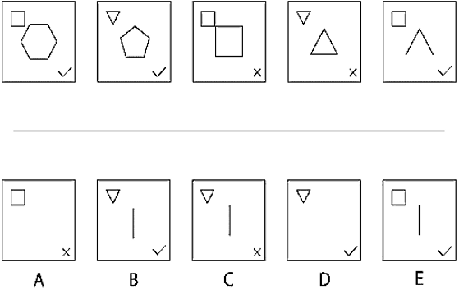
Inductive Reasoning Example Question
Which of the five A-E figures is next in the sequence?
Source: www.assessmentday.co.uk

Slide 23
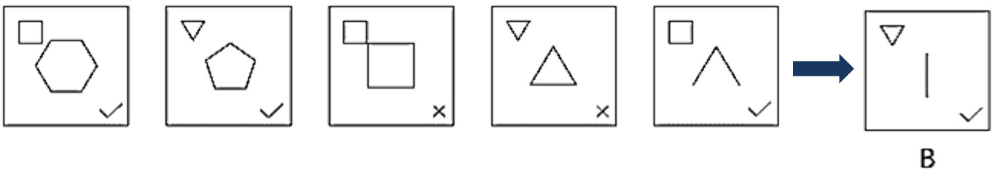
Inductive Reasoning - ANSWER
1st Rule: The shape in the centre comprises 1 fewer straight line every time.
2nd Rule: The shape in the top left alternates between being a triangle and being a square.
3rd Rule: There is a cross when both shapes have the same number of sides, and a tick when they have different numbers of sides.
Answer: B
Source: www.assessmentday.co.uk

Slide 24
Personality Questionnaires
Designed to help you to clarify your personality type or personality traits
Used by some employers as part of selection, but not as frequently as ability tests
Examples:
Myers-Briggs Type Inventory (MBTI)
Occupational Personality Questionnaire (OPQ)
Notes:
Personality questionnaires are not tests, there are no right or wrong answers. The examples given here are 2 very well known personality questionnaires.

Slide 25
Personality Questionnaires
Examples:
https://www.assessmentday.co.uk/personality-questionnaire.htm
https://www.cebglobal.com/shldirect/en/practice-tests
Notes:
Try a personality questionnaire to find out what they might be like.

Slide 26
Situational Judgement Tests
Designed to assess your ability to make decisions when faced with situations or problems at work.
Usually designed specifically for an employer, so practice versions are limited.
Usually designed for specific types of work.
SJTs are relatively new forms of assessment in selection but are becoming popular.
Notes:
SJTs are usually designed specifically for companies which means it is not easy to prepare for them. Questions in an SJT usually describe a work situation that requires a decision or action. Suggested options are given and applicants have to choose an appropriate option.
Example SJTs are available but may not be similar to the SJT that you might have to take. Links to 2 example tests follow.

Slide 27
Review the following situation and four possible responses.
Indicate which one you believe to be the response to the situation you would be most likely to make.
Situation:
You are a Retail Assistant working in the Saldringham branch of More Than Pens plc, a national stationer’s chain.
You are doing a stint on the till on a busy Saturday afternoon. You are working on the main bank of tills at the exit to the shop where customers from all parts of the shop can go to purchase their items. Suddenly the credit card transaction system stops working and one of the team leaders tells you that it will be 15 minutes until the system provider can fix the problem. There is a long queue of customers waiting.
Responses:
Talk to the team leader and suggest that someone goes down the line of customers informing them of the problem and how long it will take to resolve. This will save customers queuing up in case they have no cash on them.
Continue serving customers and apologise about the lack of availability of credit card payment.
Ask the team leader what to do.
Take the opportunity to take your afternoon tea break as it appears that most customers will have to come back later when the system is working again.
Source: www.assessmentday.co.uk
Notes:
This is an example of a question from a situational judgement test, taken from one of the free practice tests on the Assessment Day website.

Slide 28
Review the following situation and four possible responses.
Indicate which one you believe to be the response to the situation you would be most likely to make. - ANSWER
a) Talk to the team leader and suggest that someone goes down the line of customers informing them of the problem and how long it will take to resolve. This will save customers queuing up in case they have no cash on them.
This is the most effective response as there is nothing you can do to solve the IT problem yourself but you can give customers as much information as possible so that they can decide whether to continue queuing up or whether to come back later. Checking with the team leader is also appropriate as he or she may have a different plan and you don’t want to clash.
Source: www.assessmentday.co.uk
Notes:
Comments to other responses:
b) Continue serving customers and apologise about the lack of availability of credit card payment.
Not a particularly appropriate response as you are allowing customers to queue up when they may not be able to pay for their items when they reach the till. You will end up with angry and frustrated customers.
c) Ask the team leader what to do.
A reasonable response as it is a good idea to take advice on the situation from the person in charge and this will also ensure that you are taking the same approach as all your colleagues.)
d) Take the opportunity to take your afternoon tea break as it appears that most customers will have to come back later when the system is working again.
This is the least effective response as you do not know for sure that most customers will have to pay later and you are leaving your colleagues and team leader to deal with the situation without checking what else you could do to help.

Slide 29
Preparing for tests
Research the type of test you have to take
  Try an appropriate practice test
    Identify any weaknesses & address them
      Take a practice test again
        Have you improved?
Notes:
If you are likely to apply to companies using tests,
1. Find out:
What skill or skills they test for
Which tests they use
Whether they have example questions on their website
2. Try out an appropriate test. If the company uses numerical reasoning tests, take a practice numerical reasoning test, ideally one that provides the answers when you have finished to help you identify where you went wrong.
3. Look at your result and any tips or comment that might be provided with it:
Is the result high enough?
Are there gaps in your knowledge that you need to address e.g. Some questions that you find more difficult? If so, refresh or improve your knowledge of the specific topic. Seek help if you need to e.g. Maths support or English language support within your university.
Take another practice test when you have addressed any weaknesses
5. If you have not improved, seek advice e.g. From your university careers service.

Slide 30
Preparing for tests – ability tests
Q: Not answering many questions but getting most or all
answers correct?
A: Take more practice tests and focus on increasing your speed.
Q: Answering most or all of the questions but getting a low
score?
A: Work on your accuracy e.g. check your answers
Q: Lacking knowledge/skills?
A: Refresh your skills e.g. revise basic maths (ratios,
percentages and fractions are commonly used), learn
scanning techniques to extract key information from text.

Slide 31
Identifying weaknesses
– Situational Judgement Tests
Q: Low score?
A:
  Use only the information provided in the question.
  Read the question and information carefully before answering.
  Ensure you know the competencies required for success in the job.
Notes:
Because SJTs are usually designed specifically for an organisation it is difficult to practise. However, think about the nature of the work you are applying for and the skills needed. Before taking an SJT as part of a recruitment process for an organisation, research that organisation as thoroughly as you can particularly the competencies (or skills) that are sought in applicants. Read information in the recruitment pages of the organisation’s website including any case studies or interviews with existing employees to get a sense of the kind of day to day work and the decisions that might have to be made.

Slide 32
Understanding Personality Questionnaires
These are not tests
It is less likely that there are ‘right’ or ‘wrong’ answers
Answering honestly is usually recommended
Follow the instructions

Slide 33
General Practice Test Sites
www.assessmentday.co.uk
www.graduatesfirst.com
Answers are provided after taking each test, so you can analyse where you are going wrong.
Tips and advice are also provided.
Both sites include practice tests of non-verbal reasoning
Notes:
These sites include free practice tests that provide answers and explanations. This is particularly helpful as you can identify any areas in which you need to improve.

Slide 34
Practice Tests Offered by Test Producers
CEB Gartner (SHL)
https://www.cebglobal.com/shldirect/en/practice-tests
Cubiks
https://practicetests.cubiks.com/
Talentlens (Pearson)
https://www.talentlens.co.uk/practice-aptitude
Saville Assessment
https://www.savilleassessment.com/PracticeTests
TalentQ
https://www.trytalentq.com/
Capp
http://practice.cappassessments.com/
You may have to register & create a password before taking a practice test
Notes:
These well known companies produce tests to be used in recruitment. They publish example questions and in some cases, practice tests too. Many of these sites will require you to register, with basic personal details, and create a password in order to take their practice test. Some may offer the opportunity to take a new test as part of a trial.

Slide 35
Sources of Support in Your University
Maths support service
English language support service
Your careers service might offer:
- Information about taking tests on their websites
- Opportunities to practise tests and receive feedback
- Discussion with an adviser to address your concerns
- Links to websites with practice tests

Slide 36
Other Useful Resources
Online courses e.g.
https://www.futurelearn.com/courses/numeracy-skills
https://www.futurelearn.com/courses/workplace-english
https://www.futurelearn.com/courses/logical-and-critical-thinking
Books e.g.
‘How to Pass Graduate Psychometric Tests’ M Byron
‘How to Pass Diagrammatic Reasoning Tests’ M Byron
Notes:
When looking at resources, including books, ensure that they are at the correct level e.g. Graduate, Professional or Advanced.

Slide 37
Thank you
Any questions ???

